Slide 1

CXBN-2 Science: characterization of detector prototype and development of data analysis protocol
Biswas Sharma
Mentors: Dr. Thomas Pannuti, Prof. Jeff Kruth,
Dr. Benjamin Malphrus, Dr. Dirk Grupe
4/22/2015

Slide 2
Slides Progression
Introduction
CZT Detector Array
Characterization
Data Analysis
Future Work

Slide 3
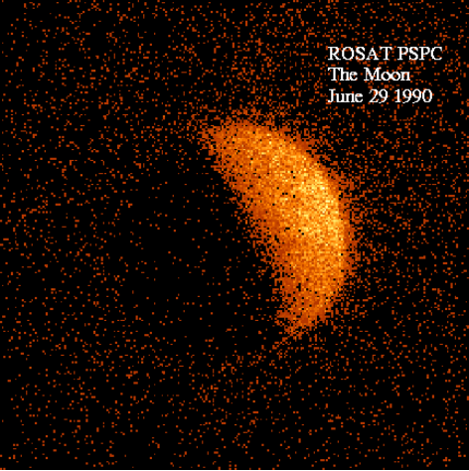
The X-ray Sky
In search of fluorescence of solar X-rays from the moon:
Notes:
To begin with, I could spend a lot of time talking about the history of the cosmic x-ray background detection. However, the ROSAT image you can see on the screen is very succinct and tells you a lot about the x-ray background. More than two decades ago, when researchers were trying to measure the fluorescence of solar x-rays from the bright side of the moon, they found out that there was a consistent background present in the image. This X-ray background, as you can see in the image, was found to be somehow blocked by the dark side of the moon. This made it clear that the x-ray background had to be coming from outside the solar system.

Slide 4
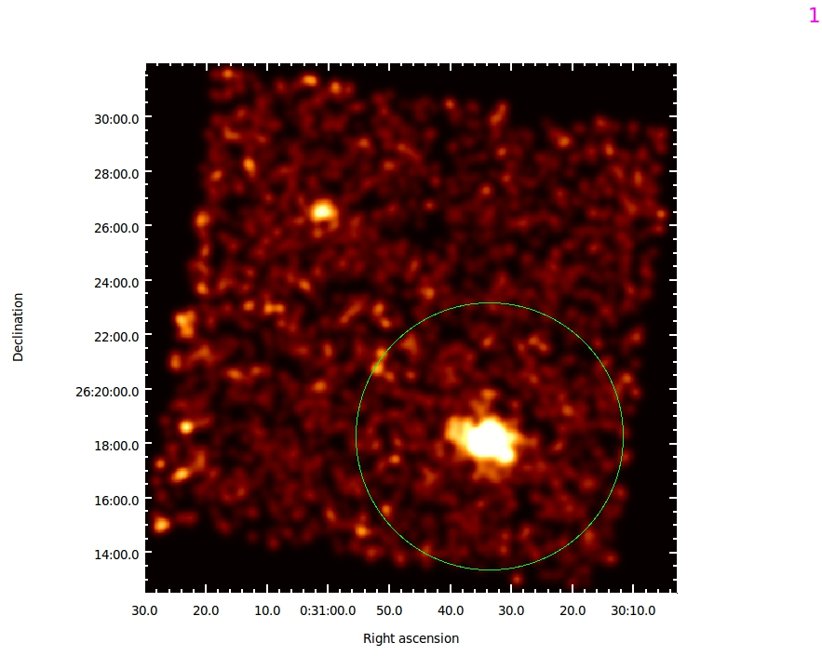
The X-ray Sky
Diffuse background
Galaxy cluster
Chandra observation of galaxy cluster CL0030+2618
Notes:
Then, with the advancement of detector technology, we were able to resolve objects farther in the sky. The X-ray background was still persistent. Researchers had a consensus that the background could have a galactic origin. However, with more and more observations of objects all over the sky, it became clear that even though a lot of the low-energy emission of the x-ray background came from the galactic plane, most of the emission, above 10 keV, was isotropic. The image you can see on the screen is a Chandra X-ray Observatory image of a galaxy cluster. The image clearly shows X-ray emission coming from the core and from the intra-cluster medium within the galaxy cluster. However, as the image reveals, there is an emission in the same energy range coming from the background as well.

Slide 5
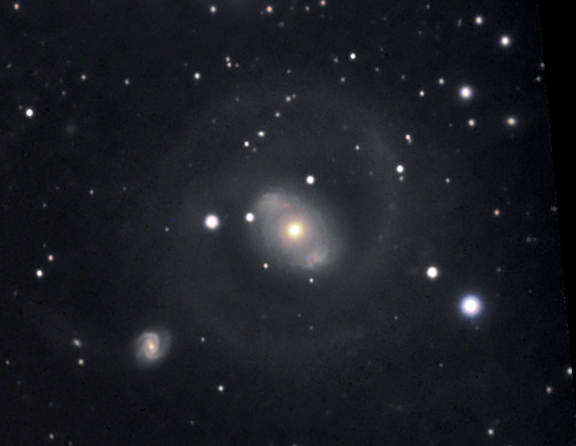
The X-ray Sky
NGC 4151
Notes:
This is an optical image of the galaxy NGC 4151.

Slide 6
The X-ray Sky
NGC 4151
A bright Active Galactic Nucleus (AGN)
outside our galaxy
Flux
Position
Notes:
If you observe this galaxy in the X-ray wavelength, you can see a plot of x-ray flux as a function of position which peaks at the position of the galaxy.

Slide 7
The X-ray Sky
We know where this intensity is
coming from
But what about
this Diffuse Background?
Flux
Position
Notes:
However, there is also a consistent background flux present in the measurement, and that does not correlate to any resolved source in the sky.

Slide 8
The X-ray Sky
Is the Diffuse X-Ray Background (DXRB) due to AGN that are too distant to resolve with our telescopes or something else?
“… the cosmic X-ray background (CXB), still remains one of the most interesting topics of X-ray astronomy and observational cosmology.”
- Revnivtsev et al. 2003, A&A, Volume 411, Pages 329-334
Flux
Position
Notes:
Astrophysical models developed by researchers tell us that this emission could be coming from Active Galactic Nucleii that are too far to be resolved by our telescopes. However, this argument comes with a lot of doubts, and the nature of this diffuse cosmic x-ray background remained one of the most interesting topics of X-ray astronomy and observational cosmology.

Slide 9
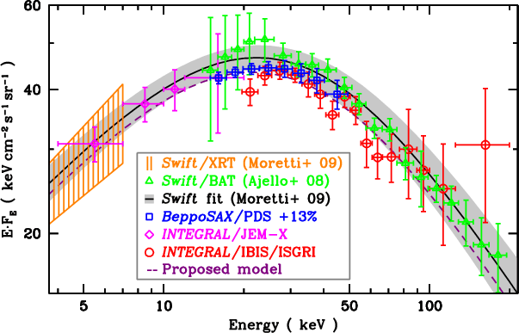
CXRB Measurement
Previous measurements of DXRB disagree by about 10%
Comparison of past CXB measurements (Türler et al. 2010)

Slide 10
CXRB Measurement
Valuable for many reasons:
Observational constraint in the study of the very high redshift (z>6) AGNs which will remain unresolved even with the next generation of X-ray telescopes (Salvaterra et al. 2007; Rhook & Haehnelt 2008)
Ensure proper background subtraction when studying objects emitting radiation in the same energy range (clusters and groups of galaxies) (Gastaldello et al. 2007; Snowden et al. 2008)
Lend insight into the evolution of primordial galaxies

Slide 11
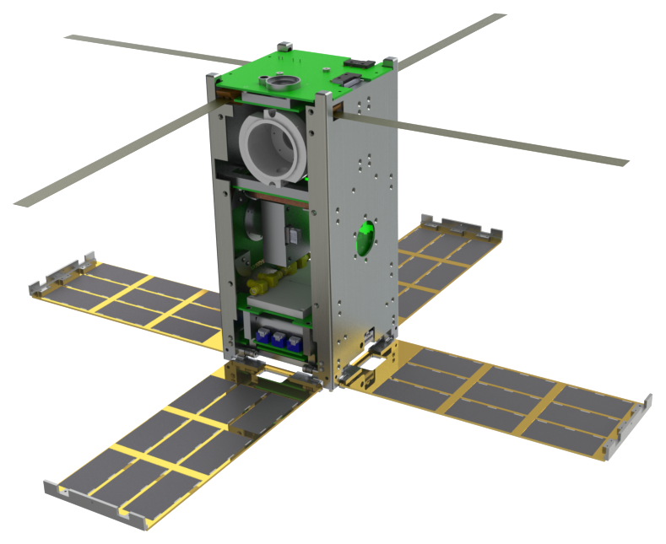
Cosmic X-ray Background Nanosatellite - 2
2U CubeSat with 2 Cadmium-Zinc-Telluride (CZT) detectors

Slide 12
CXBN-2 Science objectives
3 million seconds of data
~1 year of operation
Broadband S/N ~250

Slide 13
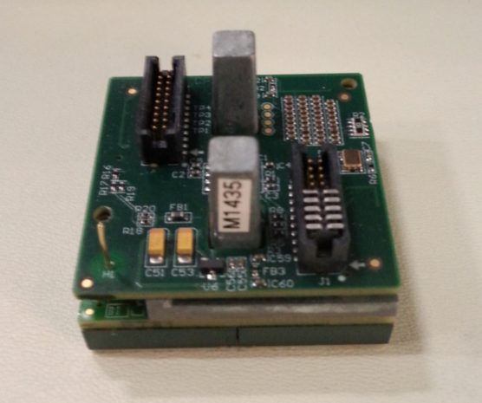
CZT Array
COTS REDLEN M1770 Gamma Imaging Module
2 Detectors in detector system
Reduces systematic uncertainty
Energy Range: 20- 50 keV
Mass: 200 g
Detector Area: 40x40 mm
16 X 16 array 2.46 mm pixel pitch
Redlen Gamma Imaging Module

Slide 14
Detector characterization and Data Analysis
Characterization
Radioisotopes
Pixel by pixel
Data Analysis
Standard software such as XSPEC
Open to scientific community

Slide 15
Radioisotopes used in characterization
Barium-133 – 30.7 keV, 53.2 keV, 80.1 keV, 356 keV
Cadmium-109 – 22.1 keV, 88 keV
Cobalt-57 – 4.4 keV, 122.1 keV, 136.5 keV
Americium-241 – 59.5 keV
www.nucleide.org

Slide 16
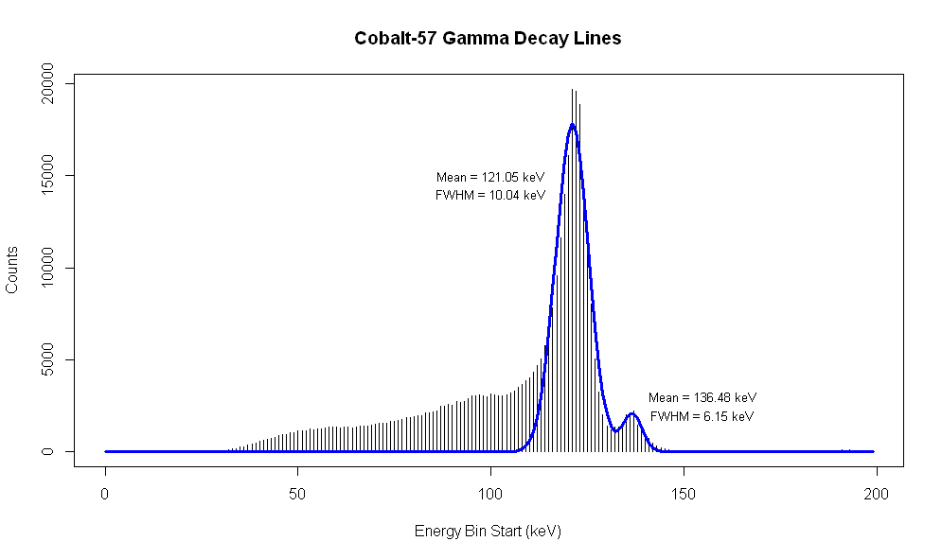
10.03701
10.03701
Detector characterization
Characterization of CXBN-2 CZT array using Cobalt-57 source in laboratory
Histogram of the measurement of 122.1 keV X-Ray from Cobalt-57 gamma decay, side peak at 136.5 keV

Slide 17
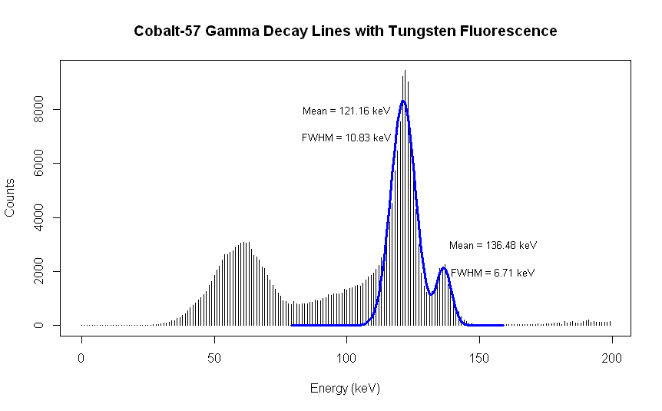
Detector characterization
Characterization of CXBN-2 CZT array using Cobalt-57 source in laboratory
Histogram of the measurement of 122.06 keV and 136.47 keV photons from Cobalt-57 gamma emissions with tungsten fluorescence at 59.32 keV and 67.24 keV

Slide 18
Detector characterization
Characterization of individual pixels

Slide 19
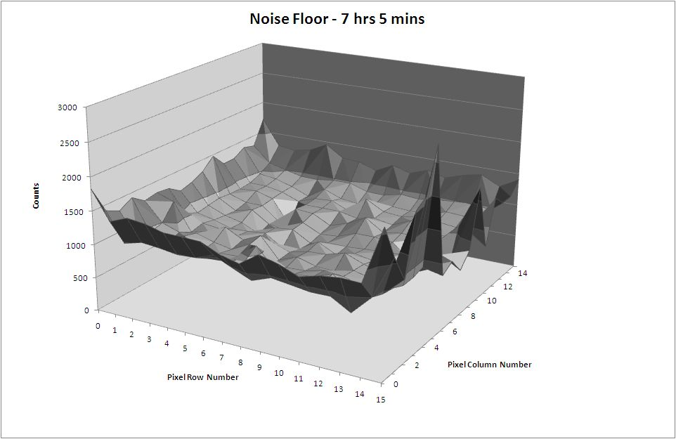
Detector characterization
Preliminary result of noise floor measurement

Slide 20
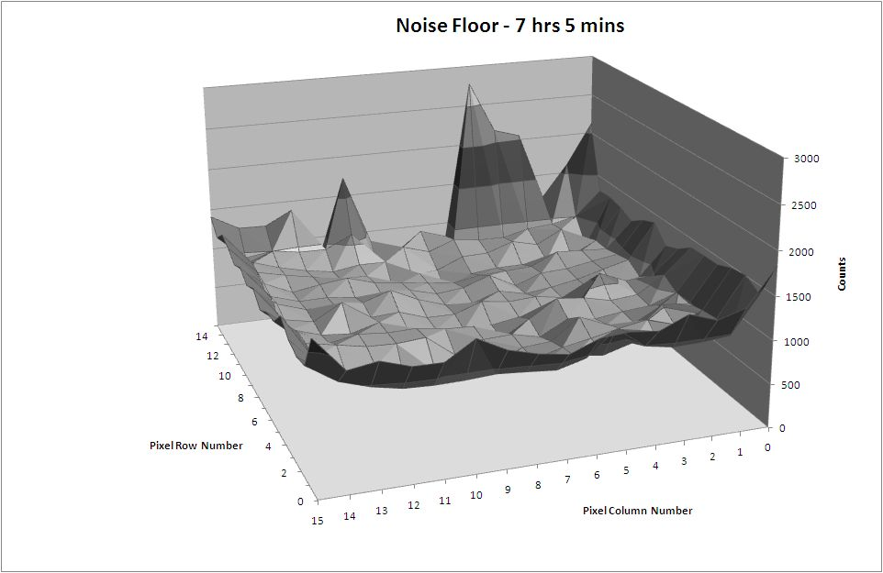
Detector characterization
Preliminary result of noise floor measurement

Slide 21
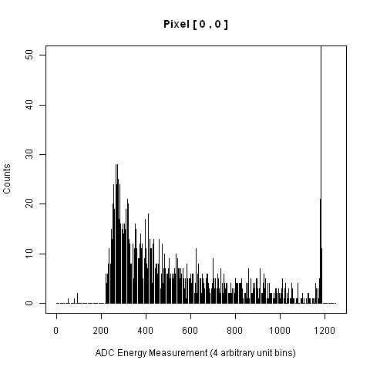
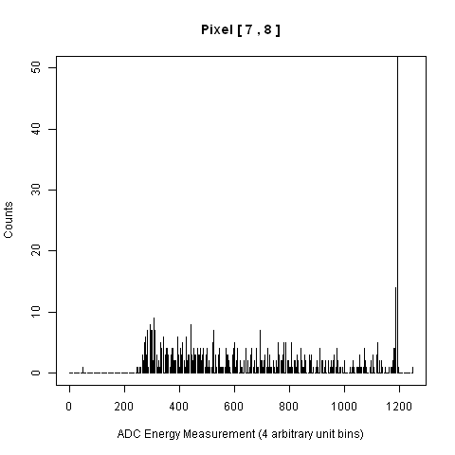
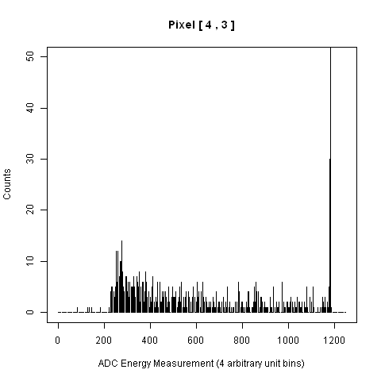
Detector characterization
Noise floor spectra from individual pixels

Slide 22
Data Analysis
Data in format analyzable by scientific community
Standard analysis software: XSPEC
Needs detector response along with data file
Redistribution Matrix File (RMF)
Detector Count Rate = Redistribution Matrix × Flux Density

Slide 23
Creating the Redistribution matrix
Source with known flux at desired energy band
Collimate over a single pixel
=> Each pixel is independently a detector
Measure count rate
Detector Count Rate = Redistribution Matrix × Flux Density
Repeat for other energy bands: Energy range of interest: 20-50 keV
Repeat for other pixels

Slide 24
Creating the Redistribution matrix
Pixel response elements positions in the redistribution matrix for a particular energy band
1,1 | 1,2 | 1,3 | .. | .. | .. | .. | .. | 1,254 | 1,255 | 1,256
2,1 | 2,2 |  |  |  |  |  |  |  |  | :
3,1 |  | 3,3 |  |  |  |  |  |  |  | :
: |  |  | 4,4 |  |  |  |  |  |  | :
: |  |  |  | . |  |  |  |  |  | :
: |  |  |  |  | . |  |  |  |  | :
: |  |  |  |  |  | . |  |  |  | :
: |  |  |  |  |  |  | 253,253 |  |  | 253,256
254,1 |  |  |  |  |  |  |  | 254,254 |  | 254,256
255,1 |  |  |  |  |  |  |  |  | 255,255 | 255,256
256,1 | 256,2 | 256,3 | .. | .. | .. | .. | .. | 256,254 | 256,255 | 256,256

Slide 25
Creating the Redistribution matrix
Results from preliminary analysis showing response of illuminated and unilluminated pixels

Slide 26
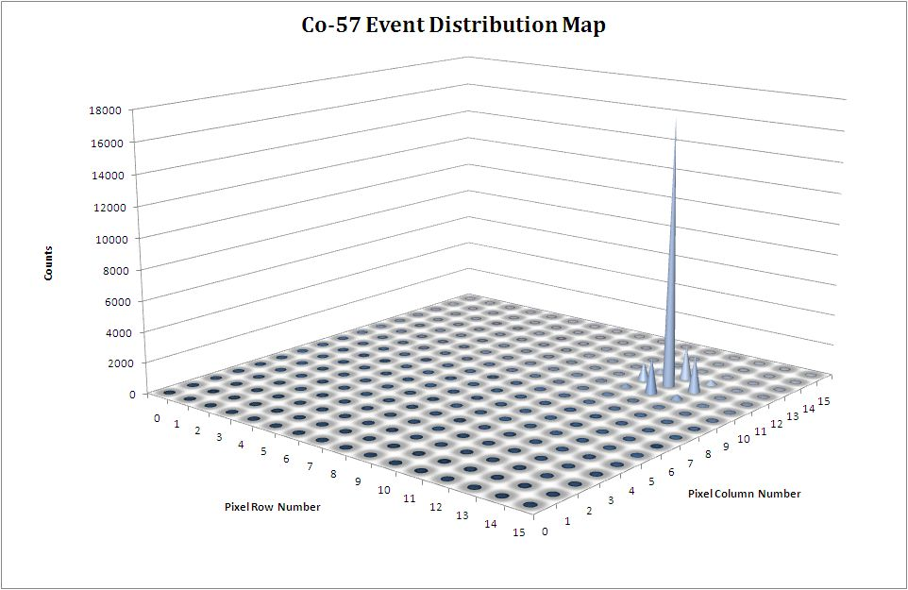
Creating the Redistribution matrix
Results from preliminary analysis showing response of illuminated and unilluminated pixels

Slide 27
Future work
Apply calibrations to individual pixels
Use Americium source to fill in redistribution matrix elements at the end of the energy range (59.5 keV)
Minimum measurable photon energy
Packetization of data and correlation with spacecraft sensors need to be determined and optimized to meet downlink constraints

Slide 28
Summary
CXRB: Poorly understood
CXBN-2: CubeSat with 2 CZT arrays
Detector arrays being characterized at MSU Space Science Center
Data analysis to be aided with redistribution matrix

Slide 29
Thanks
Sean McNeil
Jordan Healea
Dr. Roger McNeil
Ian Ray
Sonny Ernst
Mason Bush
Taylor Barber
Michael Robbins

Slide 30
Questions?

Slide 31
Thank You!

Slide 33
Additional slides

Slide 34
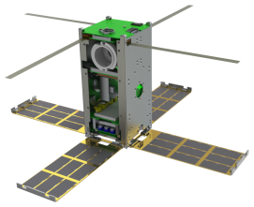
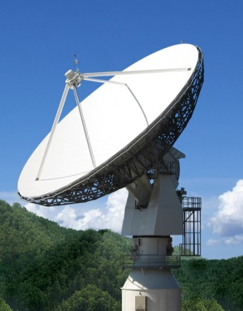
Operations: chain of events
ADC output of X-ray events to data file
Correlation of CZT data with GPS, IR sensors
Data packets optimized for UHF beacon/ S-band downlink by in-flight software
Real-time data packets transmitted to Earth station(s) and archived
Data reduction and analysis with standard software

Slide 35
Data format (Science Array)
Array data parsed together from bits [20:1] of the received string sent from the Science Array.
“Energy Data”- ADC count converted from the analog voltage signal produced from the event.
The Science array includes a 12-bit ADC.
“Pixel Address”- Address of the pixel where the event occurred.
The CZT crystal is composed of 256 separate pixels.
“Bsy”, “Err” - Status flags
“Prty” - Even parity bit

Slide 36
Calibration Code
pixel_data[x][y].calibration_slope =
(Co57_GAMMA2 - Co57_GAMMA1)/(x2*BIN_SIZE - x1*BIN_SIZE);
pixel_data[x][y].calibration_offset =
Co57_GAMMA2 - x2*BIN_SIZE*pixel_data[x][y].calibration_slope;
///// y-intercept of the calibration plot with actual values on y axis and adc values on x axis

Slide 37
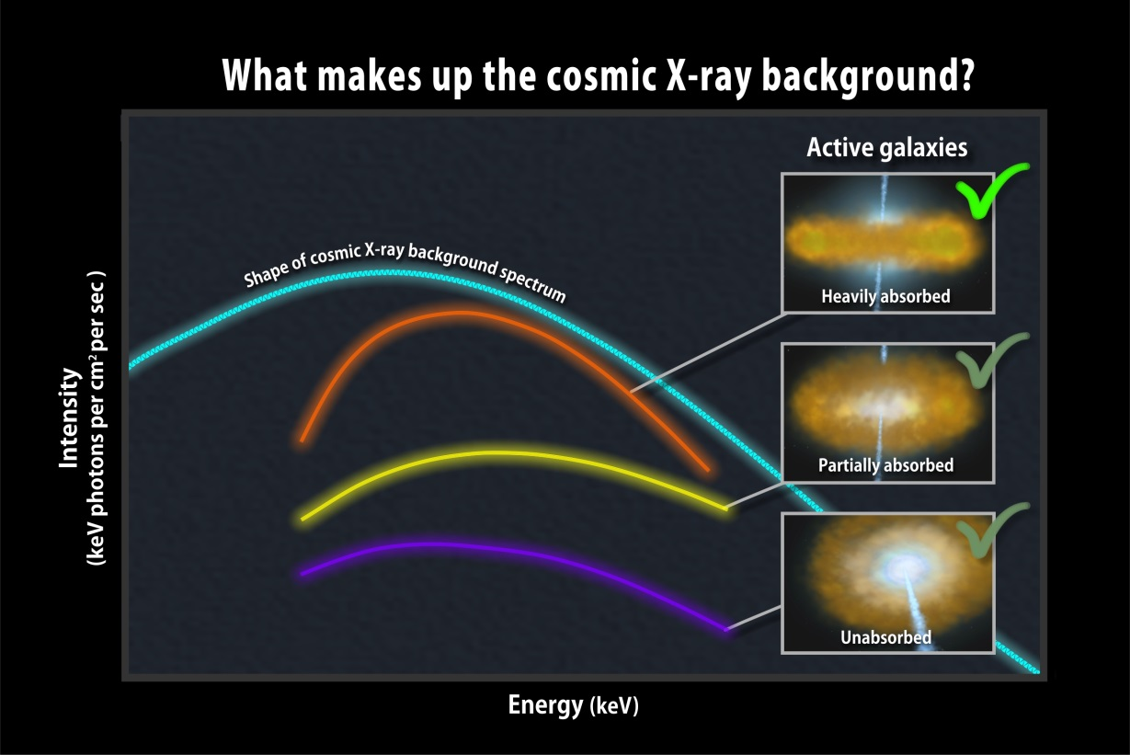
CXRB Measurement

